Slide 1
Software Testing

Slide 2
Contents
Software Development Life Cycle - Testing
What is S/W testing?
Quality Assurance and Quality control
Verification and Validation
Manual and Automated Testing
Types of testing?
  Types of Black Box Testing
Software Test Life Cycle
Test Cases and its format.
Severity and Priority
When to stop testing?
Other things to know
Things to remember

Slide 3
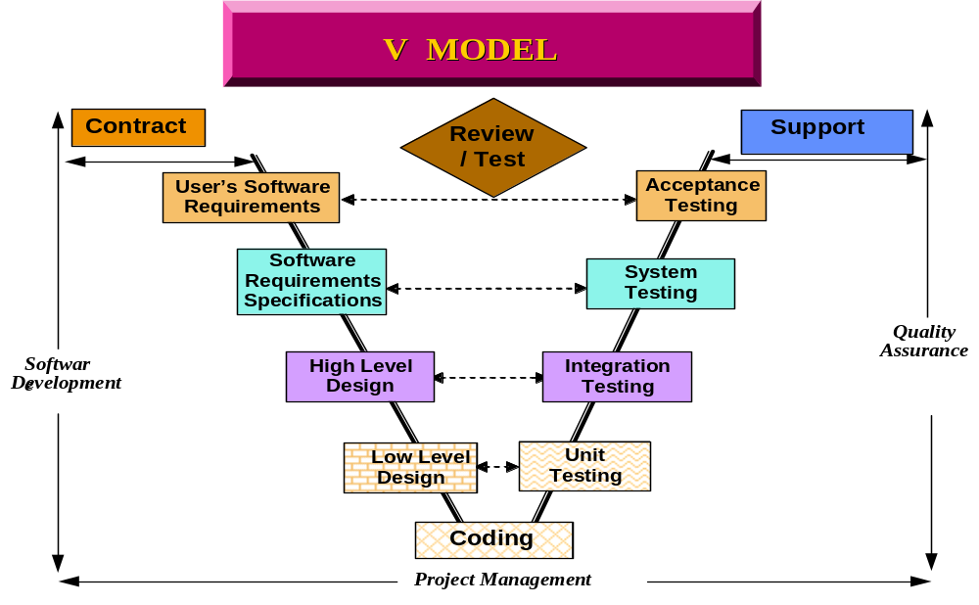
Software Development Life Cycle - Testing

Slide 4
What is S/W testing?
An activity aimed at evaluating an attribute or capability of a program or system to determine that it meets its required results. The process of exercising or evaluating a system or system component by manual or automated means to verify that it satisfies specified requirements or to identify differences between expected and actual results.

Slide 5
S/W Test Life Cycle
Test Case prepared
by Tester
Is there a bug?
Is there a bug?
Regression testing
Testing completed
Assign Severity:
Fatal, Major, Minor or
Recommendation
Send the bug to
Author
Whether bug is
closed, deferred
or rejected?
Close
Rejected/Deferred

Slide 6
Quality Assurance and Quality control
Quality Assurance: is a work Process oriented. They measure the process, define deficiencies and suggest improvement. It involves the series of inspections, reviews and tests used throughout the S/W process to ensure each work product meets the requirements placed under it.
Quality Control: is work product oriented. They identify deficiencies measure the product and suggest improvement. It consists auditing and reporting functions of management with the data necessary to be informed about product quality, thereby gaining insight and confidence that product quality is meeting good.

Slide 7
Verification and Validation
Verification refers to a set of activities that ensure that software correctly implements a specific function.” Are we making the product right?”
Validation refers to a different set of activities that ensure that the software that has been built is traceable to customer requirements. “ Are we making the right product.”

Slide 8

Test case and its format
It is a document which contain input actions and the expected response to verify the functionality of the application.
Test Case Id
Test Description/Objective
Input/Entry Criteria
Expected Output
Test Status (Pass/Fail)
Test Description
Defect Severity
Steps to Reproduce
Author
Date of closure
Status
Remarks

Slide 9

Severity and Priority
Severity is assumed as how harmful the bug is for the application i.e. A, B,C, R
Priority is how quickly the bug has to be resolved to make the application bug free.

Slide 10
Testing techniques
Manual Testing: That part of Software testing that required operator input, Analysis or evaluation.
Automated Testing: That part of Software that is assisted with S/W tools that does not require operator input, analysis or evaluation. These are the Automated tools available in the market - Win runner, Load runner, Test director, QTP, Rational Robot, Jmeter etc.

Slide 11
Types of Testing
White Box Testing: Testing approaches that examine the program structure and derive test data from the program logic. This is also known as clear box testing, glass box or open box testing. White box testing determines if program-code structure and logic is faulty. It is done by developers.
Unit Testing: The testing is done to show whether a unit (the smallest piece of software that can be independently compiled or assembled, loaded and tested) satisfies its functional specification or its implemented structure matches the intended design structure. It is done by developers. Unit testing is part of White Box Testing.

Slide 12
Types of Testing
Black Box Testing: Functional testing based on requirements with no knowledge of the internal program structure or data. Also known as closed box testing. Black box testing indicates whether or not a program meets required specifications by spotting faults of omission- places where the specification is not fulfilled. It is done by testers.

Slide 13
Types of Black Box Testing
Function Testing: Application of test data derived from the specified functional requirements without regard to the final program structure.
Integration Testing: An orderly progression of testing in which software components or hardware components or both are combined and tested until the entire system has been integrated.
User Acceptance Testing: Formal testing conducted to determine whether or not a system satisfies its acceptance criteria enables an end user to determine whether or not to accept the system.

Slide 14
Types of Black Box Testing
System Testing: It is a process of attempting to demonstrate that a program or system does not meet its original requirement and objectives as stated in the requirement specification. It is performed by a testing group before the product is made available to customers. It can be done whenever the product has sufficient functionality to execute some of the tests or after unit or integration are over. It can be conducted parallel with functional testing.
Regression Testing: Selective retesting to detect faults introduced during modification of a system or system component, to verify that modifications have not caused unintended adverse effects or to verify that a modified system or system component still meets its specified requirements.

Slide 15
When to stop Testing
Deadlines (Release deadlines, testing deadlines)
Test cases completed with certain % passed
Test budget depleted
Coverage of code/ functionality requirements reaches at specified point
Bug rate falls below a certain level
Beta or Alpha testing period ends

Slide 16
Other things to know
Alpha Testing
Beta Testing
Adhoc Testing
Exploratory Testing
Smoke Testing
Monkey Testing
Top Down Integration Testing
Bottom Up Integration Testing
Equivalence Portioning
Boundary Value Analysis
Traceability Matrix
Test Bed
Client Server Architecture testing.

Slide 17
Things to Remember
Reminders
Collect SRS
Prepare Test Plan
Prepare Test Cases and execute it.
Prepare bug report and get fixed by developers
Do Regression Testing
QMS Reference Documents
SG_ENG_COM05 : Product Integration & Testing
PR_ENG_COM20 : Release Management
PR_ENG_COM15 : Final Inspection & Delivery
TL_ENG_COM10 : Test Plan
FR_ENG_COM15 : Test Case & Report

Slide 18
Thank You

